Slide 1
CSA
Customer segmentation analysis

Slide 2
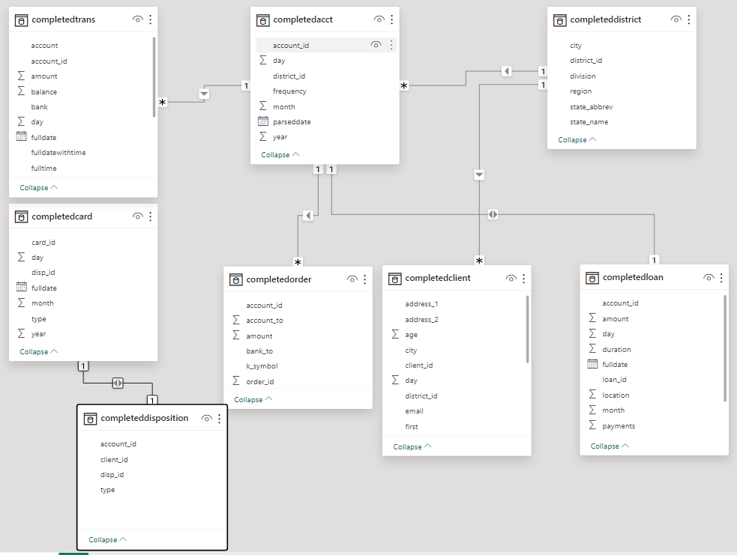

Slide 3
Demographic Segmentation:
Age: The age of the customer, often categorized into different age groups.
Gender: The gender identity of the customer.
Income: The annual income or household income of the customer.
Education Level: The highest level of education attained by the customer.
Marital Status: The relationship status of the customer.
Occupation: The type of employment or profession of the customer.
Geographic Location: The residential location of the customer.
Behavioral Segmentation:
Transaction Frequency: The number of transactions conducted by the customer within a specific time frame.
Channel Preferences: The preferred banking channels used by the customer, such as online, mobile, or in-person.
Product Usage Patterns: The frequency and types of financial products or services utilized by the customer.
Interaction History: The history of customer interactions with the company, including inquiries, complaints, and feedback.
Engagement Level: The level of engagement with marketing materials, promotions, and loyalty programs.
Life Events: Significant life events that may influence financial behavior, such as marriage, birth, or retirement.
Psychographic Segmentation:
Financial Goals and Values: The long-term financial objectives, values, and attitudes toward money held by the customer.
Risk Perception and Financial Attitudes: The perception of risk, willingness to take risks, and attitudes toward financial decisions.
Tech-Savvy Behavior: The comfort level with technology, adoption of digital banking tools, and preferences for digital versus traditional banking.
Lifestyle Preferences: The lifestyle choices, hobbies, interests, and spending habits of the customer.
Social Responsibility: The commitment to social responsibility, environmental sustainability, and ethical investing.
Segmentation based on Risk Profile:
Risk Tolerance: The willingness and ability to tolerate investment risk.
Creditworthiness: The credit history, credit score, and credit utilization of the customer.
Investment Preferences: The preferences for investment products, asset allocation, and investment strategies.
Financial Stability: The financial stability indicators, including income stability, employment status, and debt-to-income ratio.
Past Financial Behavior: The history of financial decisions, including investment performance, debt management, and savings habits.

Slide 4
Data points required to analyse customer segmentation
Data Points | Demographic Segmentation | Behavioral Segmentation | Psychographic Segmentation | Segmentation based on Risk Profile
Age | ✔️ | ✔️ | ✔️ | ✔️
Gender | ✔️ |  | ✔️ | ✔️
Income | ✔️ |  |  | ✔️
Education Level | ✔️ |  |  | ✔️
Marital Status | ✔️ |  |  | ✔️
Occupation | ✔️ |  |  | ✔️
Geographic Location | ✔️ |  |  | ✔️
Transaction Frequency |  | ✔️
Channel Preferences |  | ✔️
Product Usage Patterns |  | ✔️
Interaction History |  | ✔️
Engagement Level |  | ✔️
Life Events |  | ✔️
Financial Goals and Values |  |  | ✔️
Risk Perception and Financial Attitudes |  |  | ✔️
Tech-Savvy Behavior |  |  | ✔️
Lifestyle Preferences |  |  | ✔️
Social Responsibility |  |  | ✔️
Risk Tolerance |  |  |  | ✔️
Creditworthiness |  |  |  | ✔️
Investment Preferences |  |  |  | ✔️
Financial Stability |  |  |  | ✔️
Past Financial Behavior |  |  |  | ✔️

Slide 5
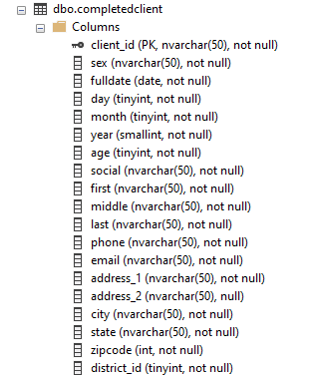
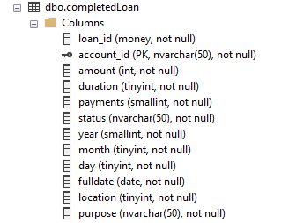
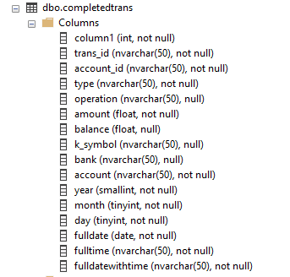
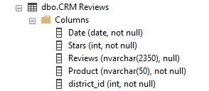
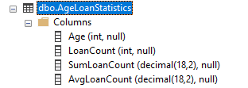
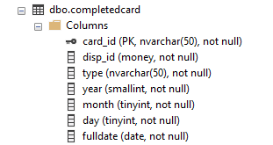
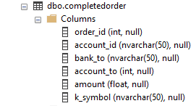
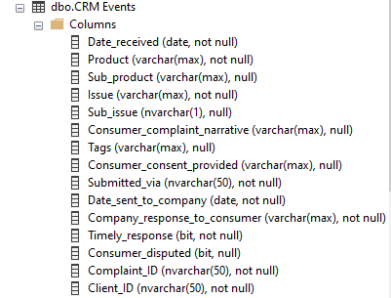
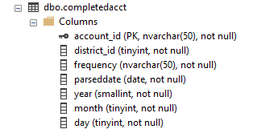
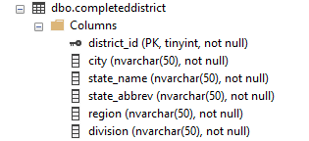
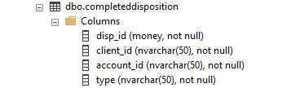

Slide 6
Data Points | Demographic Segmentation | Behavioural Segmentation | Psychographic Segmentation | Segmentation based on Risk Profile | Availability of data | SQL Queries
Age | ✔️ | ✔️ | ✔️ | ✔️ | YES | SELECT
Gender | ✔️ |  | ✔️ | ✔️ | YES | SELECT
Income | ✔️ |  |  | ✔️
Education Level | ✔️ |  |  | ✔️
Marital Status | ✔️ |  |  | ✔️ | YES
Occupation | ✔️ |  |  | ✔️
Geographic Location | ✔️ |  |  | ✔️ | YES
Transaction Frequency |  | ✔️ |  |  | YES | CALCULATED DATA
Channel Preferences |  | ✔️ |  |  | YES
Product Usage Patterns |  | ✔️ |  |  | YES
Interaction History |  | ✔️ |  |  | YES
Engagement Level |  | ✔️ |  |  | YES
Life Events |  | ✔️
Financial Goals and Values |  |  | ✔️
Risk Perception and Financial Attitudes |  |  | ✔️
Tech-Savvy Behaviour |  |  | ✔️ |  | YES
Lifestyle Preferences |  |  | ✔️
Social Responsibility |  |  | ✔️
Risk Tolerance |  |  |  | ✔️
Creditworthiness |  |  |  | ✔️
Investment Preferences |  |  |  | ✔️
Financial Stability |  |  |  | ✔️
Past Financial Behaviour |  |  |  | ✔️ | YES

Slide 7
Data set general shape
Null data | Yes, | Columns and rows
Dataset | 13 csv | Not using all tables
Time series | 2013 - 2018
Client | Count: 5370
Loan | Count: 683 | Total amount: 130M
Geographies | US only | Full addresses available, some elements made up | Includes bank proprietary designation
Transaction count | Count: >1M

Slide 8
OneDrive host
DATASET
Accessed via MS Server management Studio
SQL based data creation and table creation
Working dataset
Piloted via GitHub
Excel to create pivots
PowerBI
Pivot Tables
Dataset visualisation
Python analysis

